Slide 1

Getting around the React Ecosystem
Anastasiia Roiek 501group

Slide 2

The React Ecosystem is rich and ever-evolving. The tooling and technique for building React apps are getting better day-by-day. In this post, we will take a look at the React ecosystem and where we are in 2023.

Slide 3
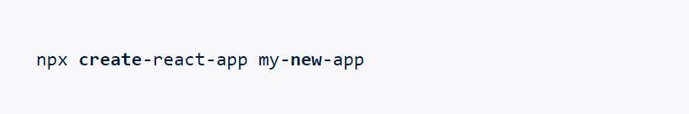
01
Create React App:
The official way of setting up a react project which takes away the pain points of custom Webpack config along with babel. CRA has been prevalent in the industry for quite a long time and hence used by people either starting their React journey or those already shipping to the production.
According to the official CRA documentation:
"Whether you’re using React or another library, Create React App let you focus on code, not build tools."
To get started, simply spin-up a new React app using:

Slide 4
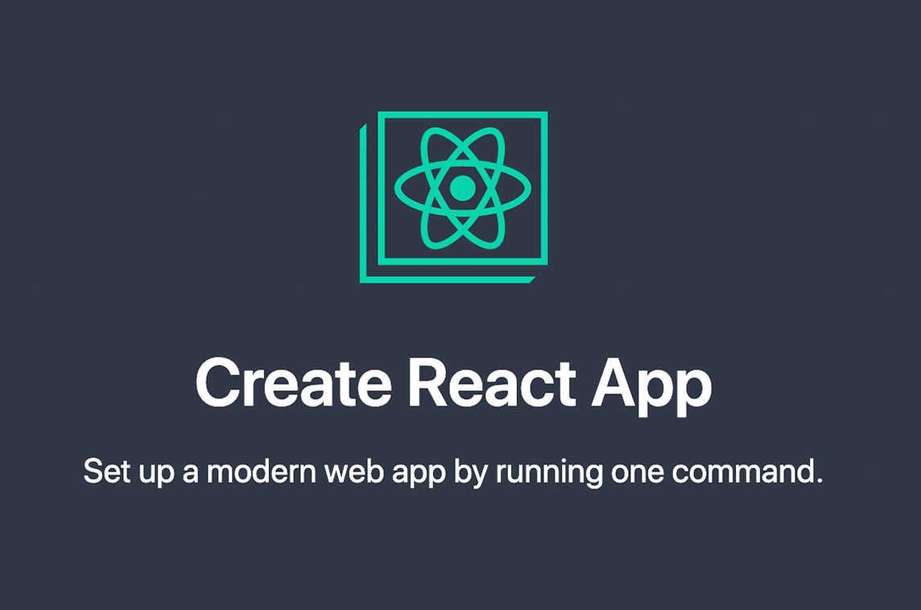
01
Create React App:
Features:
Almost no learning curve to get started.
No custom configuration necessary.
HMR (Hot Module Reloading supported (React 17).
Easy to bundle and ship.
CSS Modules and SASS files are supported.
Lacks:
Code Splitting is not supported out of the box.
Custom customization can be somewhat complicated.
CRA is bad for SEO as the application is rendered on the client-side.

Slide 5
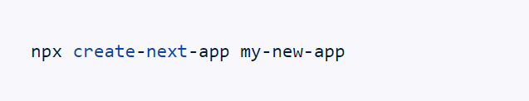
02
NextJS:
NextJS is a framework on top of React Library, leveraging the good things from both ReactJS and NextJS.
According to the official Documentation site,
"The React Framework for Production; Next.js gives you the best developer experience with all the features you need for production: hybrid static & server rendering, TypeScript support, smart bundling, route pre-fetching, and more. No config needed."
To create a new NextJS app :

Slide 6

02
NextJS:
NextJS tries to address common issues by doing a lot of things under the hood with a much-improved developer experience from development to shipping, resulting in a good leap over the create-react-app boilerplate which we initially discussed.

Slide 7

03
Webpack:
Webpack is still the most dominant and commonly used static module bundler in the industry. It is currently being used in NextJS, Create React App, Gatsby etc. Webpack5 was introduced in late Oct 2020 with a bunch of changes and a few breaking changes compared to v4.
Features:
Improved performance (compared to v4)
Persistent caching
Human Readable chunk IDs
Deprecated items from v4 has been removed in v5

Slide 8
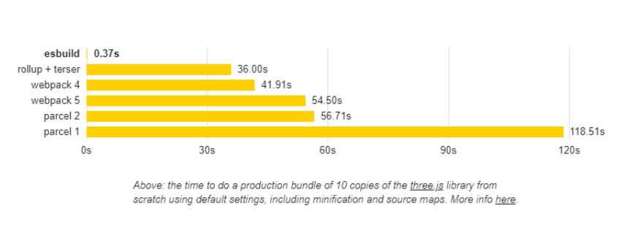
04
ViteJS::
While Webpack is present, Vitejs or similar such tool(think snowpack!) is certainly the future. It embraces the native es-modules for Dev Server and uses Rollup for the production build (compared to Webpack) ViteJs pre-bundles the dependencies using esbuild (written in Go)

Slide 9
05
Redux:
Co-authored by Dan Abramov himself, Redux was the default way to go for state management in recent React times, before the introduction of functional components. Redux pattern is still very popular among the frontend community. However, there has been a quiet decline in Redux trend either due to the much complained "boilerplate code" or the introduction useReducer, Context API if used together can behave similarly to Redux pattern.
To improve on certain Redux pain points, Redux Toolkit was introduced, which is highly opinionated and worth checking out.
Similar(or dissimilar) to Redux there are numerous third party state management libraries are out there that differs in pattern and the way of handling the global state. Few of those worth the mention are :

Slide 10
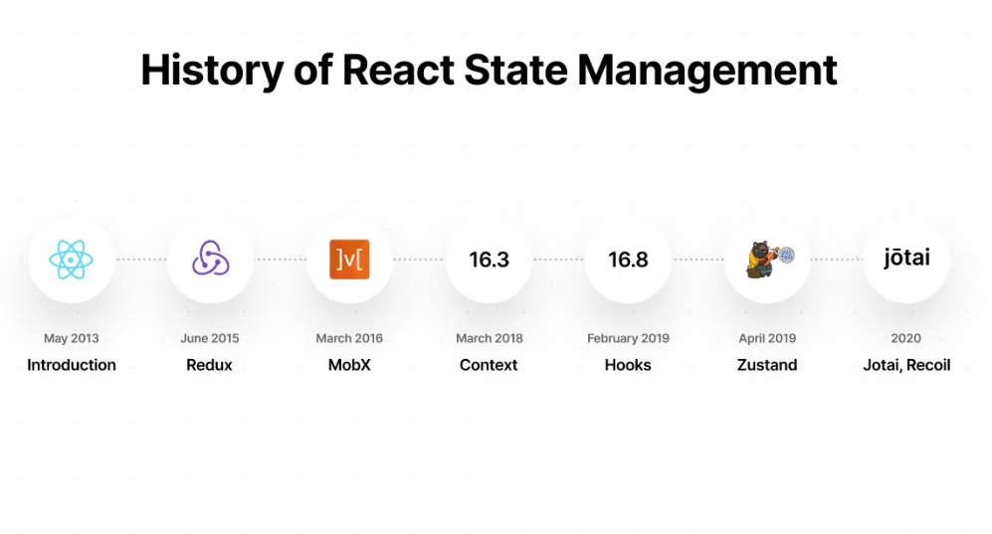
05
Redux:

Slide 11

06
React Query:
React Query was developed by keeping those above issues in mind. It makes fetching, caching, synchronizing and updating server state hassle-free.
Managing out of date stale data.
Lazy loading the requests
Reflecting updates to the data very quickly and can be explicitly managed.
Provides us with a nice UI based dev tool, similar to browser developer tools but for managing and visualizing the data fetching and synchronization.

Slide 12
THANK YOU

